Slide 1
Larkspur-Corte Madera School District
Payroll and benefits

Slide 2
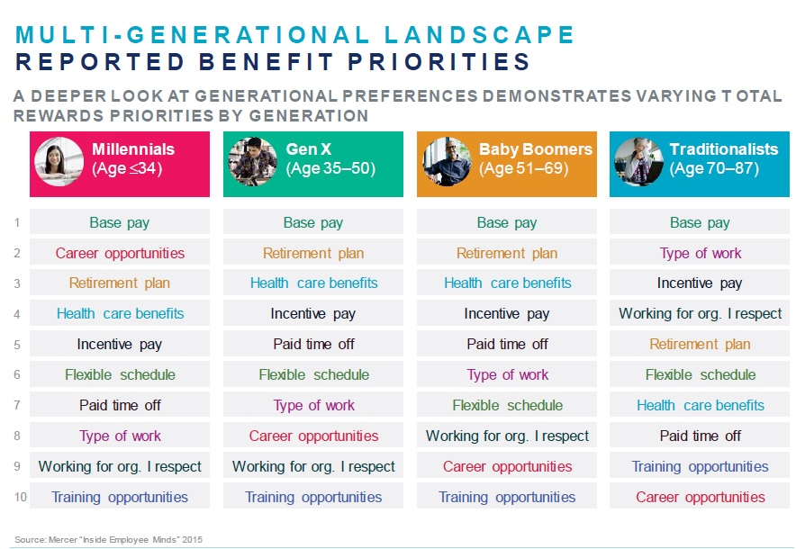

Slide 3
Payroll
Types of pay and pay dates
Understanding Your Paycheck
Hard Copy Check vs. Direct Deposit (Auto Pay and Suppression)
Employee Self Service Portal (ESS)
Deferred Pay (Summer Pay Checks)
STRS
Taxes, Disability, Voluntary Deductions (vol-deds) and other deductions

Slide 4
Types of Pay and Pay Dates
Regular Pay - Certificated staff are paid on the last work day of each month (for that month). Certificate employees will be paid over 11 months, the first pay check paid in August and the final check paid in June. (for 12 checks see Deferred Pay)
Extracurricular Duties “Extra Duty” – Any voluntary and pre-approved District authorized before or after-school activities. Extra duty time is paid at a rate of $45 per hour, prorated for fractions of an hour worked. Payment for extra duty time is the 10th of the month, following the month of work, provided hours are reported to payroll on time.

Slide 5
Understanding Your Pay Check

Slide 6
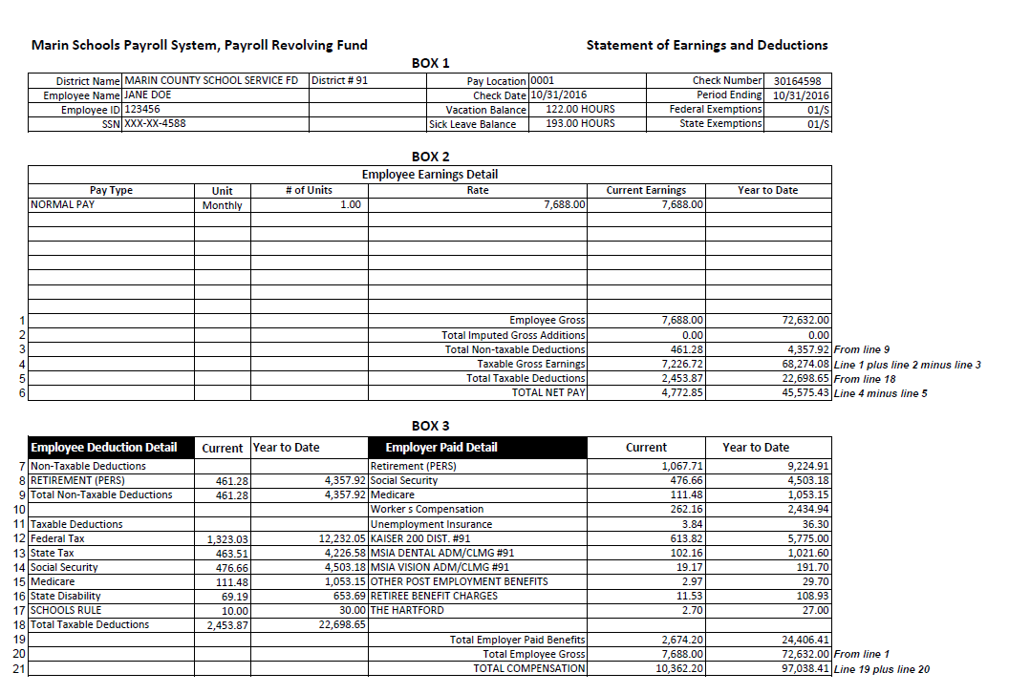
CLASSIFIED

Slide 9
Hard Copy Check vs. Direct Deposit
Employees have the option to receive either hard copy checks or direct deposit
Hard copy checks will be delivered to your main school site on pay day and you will need to sign your check out with the school secretary
Employees on direct deposit will usually see their funds deposited directly into your designated account the night before pay day. Direct deposit takes at least 2 pay cycles to activate. Until active, employees will receive a hard copy check. Direct deposit pay stubs are set for pay stub suppression (see next page regarding ESS).

Slide 10
Employee Self-Service (ESS) Portal
The ESS portal is a great online system where, once registered, an employee can view and print current and past pay stubs, view your personnel information we have on file and view and print past W2’s (as far back as 2011).
Employees must register with ESS to gain access.
If you are on direct deposit and wish to receive hard copies of your pay stubs, you can do so on the ESS portal after you register.
More information to come via email.

Slide 11
Deferred Pay
Summer pay checks differ from Regular pay checks in that they are deferred pay (net) checks.
Based upon IRS Regulation Sec. 1.451-2(a) (2006)

Slide 12
“12 equal net approach” vs. “equal gross”
Net amount will not be equal over the 12 checks (voluntary deductions, tax rates or withholding changes)
Regular check will reflect the annual salary divided by 11
All taxes and (most) voluntary deductions are taken over 11 months
1/6 of the adjusted gross is deposited into a “holding account” that is paid out at the end of June as your “summer check”

Slide 13
CalSTRS
California State Teachers Retirement System
www.calstrs.com
Name changes, address changes
Retirement planning
Beneficiaries

Slide 14
Taxes, Disability, Voluntary Deductions (vol-deds)
Non-taxable vs. taxable deductions
Federal and State taxes are based on your W-4 exemptions
LCMSD does not participate in the state disability plan. There are private vendors who offer optional plans (i.e. American Fidelity, Standard Insurance)
Voluntary-deductions (vol-deds) - Over the cap health premiums, flex accounts, cancer/life insurance premiums

Slide 15
Benefits
Sick Leave
Personal Necessity (PN), Personal Leave (PL)
FMLA and CFRA
Other Leaves
Health, Dental and Vision Benefits

Slide 16
Sick Leave
Sick hours as listed on paycheck reflects available time at the start of the current month. Sick leave is posted in arrears.
Sick leave is accrued and docked at 6 hours per day.
Ten (10) days, sixty (60) hours per year are accrued (pro-rated for FTE) at the beginning of the year. The accrued hours are earned at one (1) day, six (6) hours per month, Sept – June.
Sick hours accrued can be used before they are earned but unearned hours will be reversed should the employee terminate employment before the end of the school year.
Sick hours carry over year to year and may surrendered to STRS at the time of retirement (if retirement is from LCMSD) to be converted into service credit.
Sick hours can be transferred to another district WITHIN California up to a year after you terminate employment.

Slide 17
Personal Necessity (PN) and Personal Leave (PL)
Personal Necessity hours are directly linked to, and deducted from, your sick leave hours.
Taking Personal Necessity is limited to 7 of your 10 sick days (42 hours per 1.0 FTE - pro-rated for FTE) per year.
PN resets each year.
Each Employee accrues 1 Personal Leave (PL) day, pro-rated for FTE. The PL day must be pre-approved. PL hours do not carry over year to year.

Slide 18
FMLA and CFRA
FMLA (Family Medical Leave Act) and CFRA (California Family Rights Act)
Employed by LCMSD for at least 12 months (one school year)
Up to 12 workweeks of FMLA in a 12-month period
Leave may be taken for one of the following:
- employee’s own serious health condition
- serious health condition of employee’s child or parent (includes step)
- serious health condition of spouse (FMLA does not include domestic partners (DP) or those cohabiting CFRA allows for state registered DP)
- birth of a child or adoption of a child

Slide 19
FMLA and CFRA (con’t)
In the case of illness or injury, FMLA and CFRA run concurrently.
Paid sick leave is used first.
Differential pay is calculated (and docked) monthly at the sub’s per diem. The sub per diem is multiplied by the number of days out for a given month (not to exceed the employee’s daily rate).
Employees are entitled to five (5) months of differential pay per long-term illness or injury. The 5 months are school months (including holidays but not summer). If a portion of the 5 months remains at the end of a school year, the employee is entitled to use only the remainder in the next school year. For purposes of tracking the leave, 5 months equals 100 school days.

Slide 20
FMLA and CFRA (Maternity)
Employee must notify the Superintendent, in writing, requesting maternity leave.
FMLA and CFRA run separately in the case of maternity leave.
FMLA runs for up to 12 weeks and starts when a doctor deems the employee no longer able to work due to pregnancy (typically up to 4 weeks prior to due date) and ends when a doctor releases the employee back to work (typically 6-8 weeks after delivery).
CFRA starts when FMLA ends and runs for up to 12 weeks (can be taken intermittent within the first 12 months of birth or adoption).
Article 14, Section 9 of the LCMEA contract “Parenting Leave” runs concurrent to CFRA.
Employee maintains health and wellness benefits as provided to active employees (employee pays over the cap benefit amount).

Slide 21
Other Leaves
Jury Duty – employees who are called to served Jury duty (actually have to attend) will not be docked for time served, provided proof of service (not the summons) is submitted. Since public employees are not docked for time off for Jury Duty, we must decline the daily fee paid to jurors.
Bereavement – Employees are entitled to up to three (3) days of paid leave for the death of any member’s immediate family. The superintendent may grant an additional two (2) days when travel exceeding four hundred (400) miles is necessary (4.2 “Immediate family” means the mother, father, grandmother or grandfather of the employee or spouse, and the spouse, son, son-in-law, daughter, daughter-in-law, step-son, step-daughter, brother, sister, aunt or uncle, or any other person living in the house as the employee’s family.)

Slide 22
Health, Dental, Vision and Life Insurance Benefits
All LCMSD plans are composite rate plans = one rate for all.
$10.5k annual certificated district paid cap; $10k annual classified district paid cap
Benefit plan year = September 1st of year 1 thru August 31st of year 2
Benefits are paid in advance (i.e. August payroll deduction for September’s coverage)
$20k district paid life insurance policy (.2 FTE employees and above)
Employee and all qualified dependents can be covered. This includes your spouse, state registered domestic partner and/or children.
To add a spouse, a copy of the first page of your 2017 federal tax return (showing married status)or your marriage license (if married in 2018) is required.
To add a domestic partner, California state registered domestic partnership paperwork is required.
To add a child(ren), a copy of their birth certificate showing either the employee or spouse/domestic partner as the parent.

Slide 23
Health Benefits
All LCMSD plans are composite rate plans = one rate for all.
LCMSD offers 2 vendors - Kaiser and Blue Shield (WHA thru 9.30.18)
Kaiser offers 3 levels of coverage: Traditional, Deductible and HSA
Blue Shield offers 3 levels of coverage: 80-L, $30, Rx 9-35; HSA-B, Rx HSA-B; Anchor Bronze, Rx MVP (employee only or employee plus children coverage only – no spouse/domestic partner coverage).
Open enrollment period is August 1st - September 20th of each year with an effective date of October 1st. After initial enrollment, to add a spouse/domestic partner mid year, enrollment must occur within 60 days of the event (marriage or filing).

Slide 24
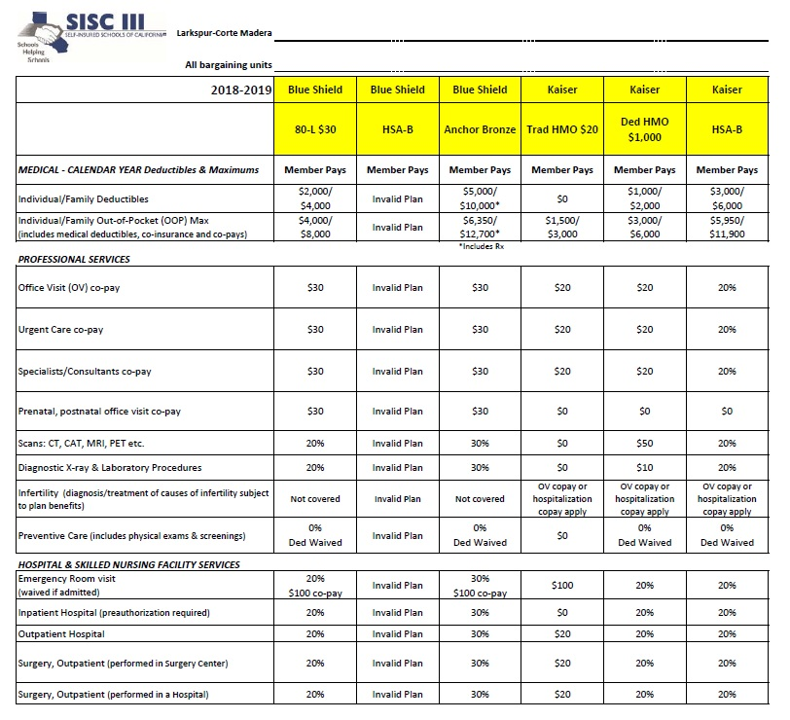

Slide 25
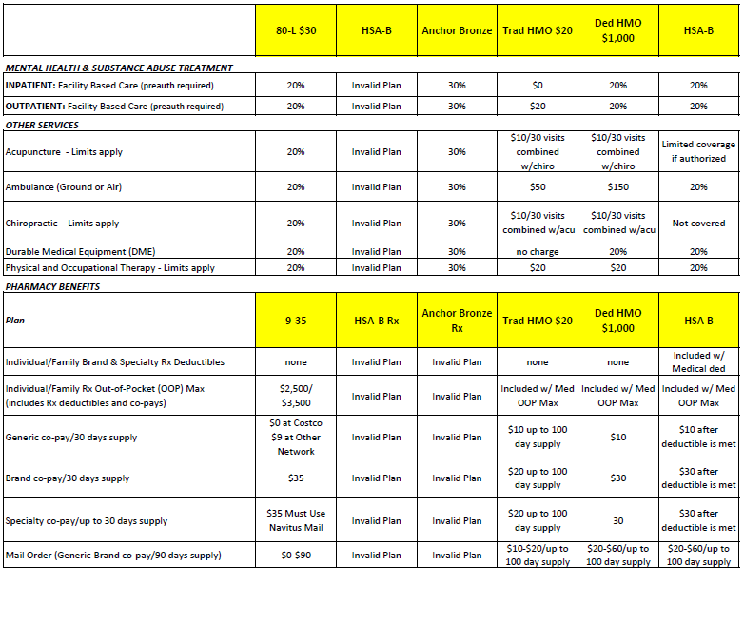

Slide 26
Dental and Vision Coverage
Dental coverage is non-voluntary for qualifying employees.
Dental and vision coverage are not included in the open enrollment period. You must enroll dependents at time of hire or with qualifying event.
LCMSD carries Delta Dental Premier coverage ($2,000 per person/year.
Employees and all dependents can be covered, includes all children, spouse/domestic partner (must be State registered). To add a spouse/domestic partner mid year, enrollment must occur within 30 days of the event (marriage or filing).
Vision is voluntary and coverage must be elected at time of hiring or with qualifying event.
Spouse or domestic partner must be added within 60 days after the date of the event.

Slide 27
Delta Dental Coverage
Eligibility – Employee, spouse (inc. state registered domestic partner) and eligible dependent children to the end of the month dependent turns age 25.
In this incentive plan, Delta Dental pays 70% of the PPO contract allowance for covered diagnostic, preventive and basic services and 70% of the PPO contract allowance for major services during the first year of eligibility. The coinsurance percentage will increase by 10% each year (to a maximum of 100%) for each enrollee if that person visits the dentist at least once during the year. If an enrollee does not use the plan during the calendar year, the percentage remains at the level attained the previous year. If an enrollee becomes ineligible for benefits and later regains eligibility, the percentage will drop back to 70%.
$2,000 per person each calendar year.

Slide 28
VSP Vision Coverage

Slide 29
Miscellaneous
Section 125 (benefits pre-tax). Sign up with American Fidelity
Personal 403b account to supplement your CalSTRS or CalPERS retirement.
Health Savings Accounts (with HSA health coverage only) can be opened through the employee’s own financial institution. Pre-tax contributions filter through monthly payroll deduction.
Flexible Spending Accounts (different from Health Savings Accounts):
To have pre-tax money set aside to pay for out of pocket medical, dental and vision non-premium services.
October 1 – September 30th plan year. Enrolled and serviced through American Fidelity. Does NOT auto-renew annually. Must be enrolled in each year.
Submit receipts for reimbursement directly to American Fidelity.
Medical and Daycare plans available.

Slide 30
Office Hours: Monday thru Friday 8:30 am – 3:00 pm ltarantino@lcmschools.org 415-927-6960, ext. 2 or 3204 within district phone system

Slide 31
Questions???

